Slide 1
6.3 Data Warehousing and Data Mining

Slide 2
What is Data Warehouse?
Defined in many different ways, but not rigorously.
A decision support database that is maintained separately from the organization’s operational database
Support information processing by providing a solid platform of consolidated, historical data for analysis.
“A data warehouse is a subject-oriented, integrated, time-variant, and nonvolatile collection of data in support of management’s decision-making process.”—W. H. Inmon

Slide 3
Data Warehouse—Subject-Oriented
Organized around major subjects, such as customer, product, sales
Focusing on the modeling and analysis of data for decision makers, not on daily operations or transaction processing
Provide a simple and concise view around particular subject issues by excluding data that are not useful in the decision support process

Slide 4
Data Warehouse—Integrated
Constructed by integrating multiple, heterogeneous data sources
relational databases, flat files, on-line transaction records
Data cleaning and data integration techniques are applied.
Ensure consistency in naming conventions, encoding structures, attribute measures, etc. among different data sources
E.g., Hotel price: currency, tax, breakfast covered, etc.
When data is moved to the warehouse, it is converted.

Slide 5
Data Warehouse—Time Variant
The time horizon for the data warehouse is significantly longer than that of operational systems
Operational database: current value data
Data warehouse data: provide information from a historical perspective (e.g., past 5-10 years)
Every key structure in the data warehouse
Contains an element of time, explicitly or implicitly
But the key of operational data may or may not contain “time element”

Slide 6
Data Warehouse—Nonvolatile
A physically separate store of data transformed from the operational environment
Operational update of data does not occur in the data warehouse environment
Does not require transaction processing, recovery, and concurrency control mechanisms
Requires only two operations in data accessing:
initial loading of data and access of data

Slide 7
DBMS vs. Data Warehouse
DBMS: (OLTP : Online Transaction Processing)
Query driven i.e.
Build wrappers/mediators on top of heterogeneous databases
When a query is posed to a client site, a meta-dictionary is used to translate the query into queries appropriate for individual heterogeneous sites involved, and the results are integrated into a global answer set
OLTP i.e.
Focuses on day to day operation of an organization such as purchasing, inventory, manufacturing, banking, payroll, registration, and accounting.

Slide 8
DBMS vs. Data Warehouse…
Data Warehouse: (OLAP: Online Analytical Processing)
Update driven i.e.
Information from heterogeneous sources is integrated in advance and stored in warehouses for direct query and analysis
Such systems can organize and present data in various formats in order to accommodate the diverse needs of the different users.
OLAP i.e.
serve users or knowledge workers in the role of data analysis and decision making.

Slide 9
DBMS vs. Data Warehouse…

Slide 10
Multidimensional Data Model
From Tables and Spreadsheets to Data Cubes
A data cube allows data to be modeled and viewed in multiple dimensions.
It is defined by dimensions and facts.
Dimensions are the entities with respect to which an organization wants to keep records.
For example, an organization may create a sales data warehouse in order to keep records of the store’s sales with respect to the dimensions time, item, branch, and location.
Each dimension may have a table associated with it, called a dimension table. This table further describes the dimensions. For example, a dimension table for item may contain the attributes item name, brand, and type.

Slide 11
Multidimensional Data Model…
From Tables and Spreadsheets to Data Cubes
A multidimensional data model is typically organized around a central theme, like sales. This theme is represented by a fact table.
Facts are numerical measures. Themes are the quantities by which we want to analyze relationships between dimensions.
Examples of facts for a sales data warehouse include dollars_sold (sales amount in dollars), units_sold (number of units sold), and amount budgeted.
The fact table contains the names of the facts, or measures, as well as keys to each of the related dimension tables.

Slide 12
Multidimensional Data Model…
Figure: Sales data for an organization according to the dimensions time, item, and location. The measure displayed is dollars_sold.

Slide 13
Multidimensional Data Model…
Figure A 3-D data cube representation of the data in above table, according to the dimensions time, item, and location. The measure displayed is dollars_sold (in thousands).

Slide 14
Multidimensional Data Model…
A data warehouse is based on a multidimensional data model which views data in the form of a data cube
A data cube, such as sales, allows data to be modeled and viewed in multiple dimensions
Dimension tables, such as item (item_name, brand, type), or time(day, week, month, quarter, year)
Fact table contains measures (such as dollars_sold) and keys to each of the related dimension tables
In data warehousing literature, an n-D base cube is called a base cuboid. The top most 0-D cuboid, which holds the highest-level of summarization, is called the apex cuboid. The lattice of cuboids forms a data cube.

Slide 15
Multidimensional Data Model…
all
0-D(apex) cuboid
time
item
location
supplier
1-D cuboids
time,location
item,location
location,supplier
2-D cuboids
time,supplier
item,supplier
time, item
time,location,supplier
3-D cuboids
time,item, location
time,item,supplier
item,location,supplier
4-D(base) cuboid
time, item, location, supplier
Figure: Cube; A Lattice of Cuboids

Slide 16
A Concept Hierarchy: Dimension (location)
all
all
region
Europe
...
North_America
country
Germany
...
Spain
Canada
...
Mexico
city
Frankfurt
...
Vancouver
...
Toronto
office
L. Chan
...
M. Wind

Slide 17
Online Analytical Processing (OLAP)
Online Analytical Processing Server (OLAP) is based on the multidimensional data model.
It allows managers, and analysts to get an insight of the information through fast, consistent, and interactive access to information.

Slide 18
OLAP Operations
Since OLAP servers are based on multidimensional view of data, we will discuss OLAP operations in multidimensional data.
Here is the list of OLAP operations:
Roll-up
Drill-down
Slice and dice
Pivot (rotate)

Slide 19
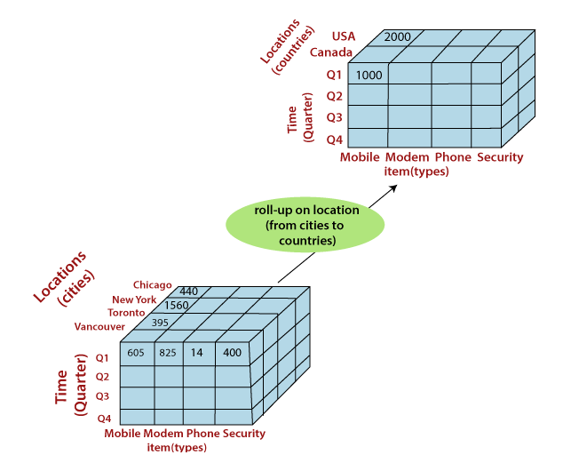
OLAP Operations
Figure: Roll up from City to Countries

Slide 20
OLAP Operations
Roll-up
Roll-up performs aggregation on a data cube in any of the following ways:
By climbing up a concept hierarchy for a dimension or by dimension reduction. The following diagram illustrates how roll-up works.
Roll-up is performed by climbing up a concept hierarchy for the dimension location.
Initially the concept hierarchy was "street < city < province < country". On rolling up, the data is aggregated by ascending the location hierarchy from the level of city to the level of country. The data is grouped into cities rather than countries.
When roll-up is performed, one or more dimensions from the data cube are removed.

Slide 21
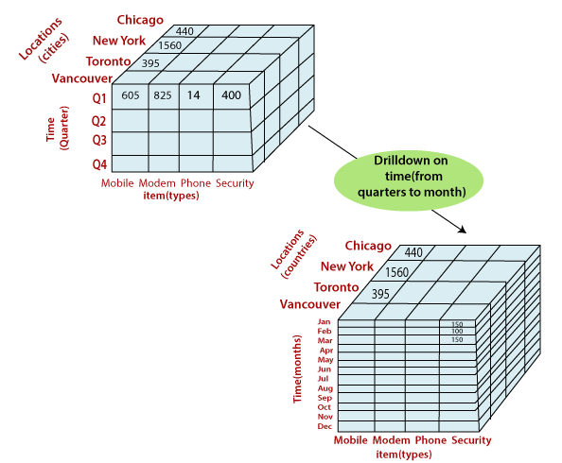
OLAP Operations
Figure: Drill down from Quarterly to months

Slide 22
OLAP Operations
Drill-down
Drill-down is the reverse operation of roll-up.
It is performed by either of the following ways:
By stepping down a concept hierarchy for a dimension or by introducing a new dimension
Drill-down is performed by stepping down a concept hierarchy for the dimension time. Initially the concept hierarchy was "day < month < quarter < year.“
On drilling down, the time dimension is descended from the level of quarter to the level of month.
When drill-down is performed, one or more dimensions from the data cube are added.
It navigates the data from less detailed data to highly detailed data.

Slide 23
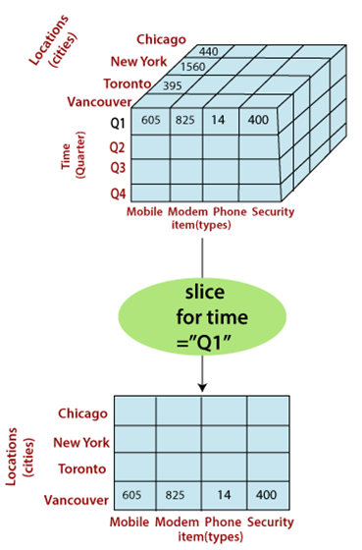
OLAP Operations
Slice
The slice operation selects one particular dimension from a given cube and provides a new sub-cube.
Consider the following diagram that shows how slice works.
Here Slice is performed for the dimension "time" using the criterion time = "Q1". It will form a new sub-cube by selecting one
Figure: Performing slice operation

Slide 24
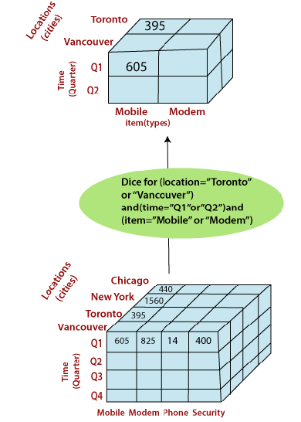
OLAP Operations
Dice
Dice selects two or more dimensions from a given cube and provides a new sub-cube.
Consider the following diagram that shows the dice operation.
The dice operation on the cube based on the following selection criteria involves three dimensions.
(location = "Toronto" or "Vancouver")
(time = "Q1" or "Q2")
(item =" Mobile" or "Modem")
Figure: Performing dice operation

Slide 25
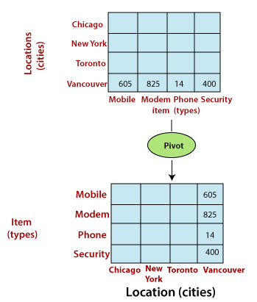
OLAP Operations
Pivot
The pivot operation is also called a rotation.
Pivot is a visualization operations which rotates the data axes in view to provide an alternative presentation of the data.
It may contain swapping the rows and columns or moving one of the row-dimensions into the column dimensions.
Figure: Performing pivot operation

Slide 26
Schemas for Multidimensional Database
Schema is a logical description of the entire database. It includes the name and description of records of all record types including all associated data-items and aggregates.
A data warehouse uses
Star
Snowflake and
Fact Constellation schema.

Slide 27
Schemas for Multidimensional Database…
Star schema: A fact table in the middle connected to a set of dimension tables
Snowflake schema: A refinement of star schema where some dimensional hierarchy is normalized into a set of smaller dimension tables, forming a shape similar to snowflake
Fact constellations: Multiple fact tables share dimension tables, viewed as a collection of stars, therefore called galaxy schema or fact constellation

Slide 28
Figure: Example of Star Schema
Schemas for Multidimensional Database…
time
time_key
day
day_of_the_week
month
quarter
year
item
item_key
item_name
brand
type
supplier_type
Sales Fact Table
time_key
item_key
branch_key
branch
location
location_key
branch_key
branch_name
branch_type
location_key
street
city
state_or_province
country
units_sold
dollars_sold
avg_sales
Measures

Slide 29
Figure: Example of Snowflake Schema
Schemas for Multidimensional Database…
time
item
time_key
day
day_of_the_week
month
quarter
year
item_key
item_name
brand
type
supplier_key
supplier
Sales Fact Table
supplier_key
supplier_type
time_key
item_key
branch_key
branch
location
location_key
location_key
street
city_key
branch_key
branch_name
branch_type
units_sold
dollars_sold
city
city_key
city
state_or_province
country
avg_sales
Measures

Slide 30
Figure: Example of Fact Constellation
Schemas for Multidimensional Database…
time
time_key
day
day_of_the_week
month
quarter
year
item
Shipping Fact Table
item_key
item_name
brand
type
supplier_type
Sales Fact Table
time_key
time_key
item_key
shipper_key
item_key
branch_key
from_location
branch
location_key
location
to_location
branch_key
branch_name
branch_type
units_sold
location_key
street
city
province_or_state
country
dollars_cost
dollars_sold
units_shipped
avg_sales
shipper
Measures
shipper_key
shipper_name
location_key
shipper_type

Slide 31
Cube Definition Syntax in DMQL
Cube Definition (Fact Table)
define cube <cube_name> [<dimension_list>]: <measure_list>
Dimension Definition (Dimension Table)
define dimension <dimension_name> as (<attribute_or_subdimension_list>)
Special Case (Shared Dimension Tables)
First time as “cube definition”
define dimension <dimension_name> as <dimension_name_first_time> in cube <cube_name_first_time>

Slide 32
Defining Star Schema in DMQL
define cube sales_star [time, item, branch, location]:
dollars_sold = sum(sales_in_dollars), avg_sales = avg(sales_in_dollars), units_sold = count(*)
define dimension time as (time_key, day, day_of_week, month, quarter, year)
define dimension item as (item_key, item_name, brand, type, supplier_type)
define dimension branch as (branch_key, branch_name, branch_type)
define dimension location as (location_key, street, city, province_or_state, country)

Slide 33
Defining Snowflake Schema in DMQL
define cube sales_snowflake [time, item, branch, location]:
dollars_sold = sum(sales_in_dollars), avg_sales = avg(sales_in_dollars), units_sold = count(*)
define dimension time as (time_key, day, day_of_week, month, quarter, year)
define dimension item as (item_key, item_name, brand, type, supplier(supplier_key, supplier_type))
define dimension branch as (branch_key, branch_name, branch_type)
define dimension location as (location_key, street, city(city_key, province_or_state, country))

Slide 34
Defining Fact Constellation in DMQL
define cube sales [time, item, branch, location]:
dollars_sold = sum(sales_in_dollars), avg_sales = avg(sales_in_dollars), units_sold = count(*)
define dimension time as (time_key, day, day_of_week, month, quarter, year)
define dimension item as (item_key, item_name, brand, type, supplier_type)
define dimension branch as (branch_key, branch_name, branch_type)
define dimension location as (location_key, street, city, province_or_state, country)

Slide 35
Defining Fact Constellation in DMQL
define cube shipping [time, item, shipper, from_location, to_location]:
dollar_cost = sum(cost_in_dollars), unit_shipped = count(*)
define dimension time as time in cube sales
define dimension item time as item in cube sales
define dimension shipper as (shipper_key, shipper_name, location as location in cube sales, shipper_type)
define dimension from_location as location in cube sales
define dimension to_location as location in cube sales

Slide 36
Data Marts
A data mart is a subject-oriented archive that stores data and uses the retrieved set of information to assist and support the requirements involved within a particular business function or department.
Data marts exist within a single organizational data warehouse repository.
Data marts improve end-user response time by allowing users to have access to the specific type of data they need to view most often.

Slide 37
Data Marts…
A data mart is basically a condensed and more focused version of a data warehouse that reflects the regulations and process specifications of each business unit within an organization.
Each data mart is dedicated to a specific business function or region.
Different data marts can be used to obtain specific information for various enterprise departments, such as accounting, marketing, sales, etc.

Slide 38
Data Warehouse Architecture
Monitor
&
Integrator
OLAP Server
Other
sources
Metadata
Operational
DBs
Extract
Transform
Load
Refresh
Analysis
Query
Reports
Data mining
Serve
Data
Warehouse
Serve
Data
Warehouse
Data Marts
Data Sources
Data Storage
OLAP Engine
Front-End Tools
Figure: Data Warehouse: A Multi-Tiered Architecture

